Slide 1
MSSP 608: Practical Machine Learning Methods Week 6
1

Slide 2
House Keeping
Quiz due tomorrow (before midnight)
Quiz 4 feedback due tonight
Homework 1 is due Wednesday (2/23) at 11:59 p.m. EST
Week 5 asynchronous learning / python script is posted

Slide 3
Reading
https://towardsdatascience.com/understanding-random-forest-58381e0602d2

Slide 4
Road Map…
Prior weeks
This week
Coming weeks
Validation | ML Algorithms
 | Supervised | Unsupervised | Reinforcement
 | Decision trees | Prin. Comp. Anal. (PCA)
Test/train (hold out cross validation) | Linear regression | K-means
K-fold cross-validation | Logistic regression | Hierarchical clustering
Stratified cross-validation | Random Forests (bagging)
Hyperparameter tuning (ridge, lasso, elastic net regression) | Gradient Boosting (xgBoost)
Ensemble learning | Naïve Bayes
Bagging | kNN
Boosting

Slide 5
Quiz #4 class average – 97%
5

Slide 6
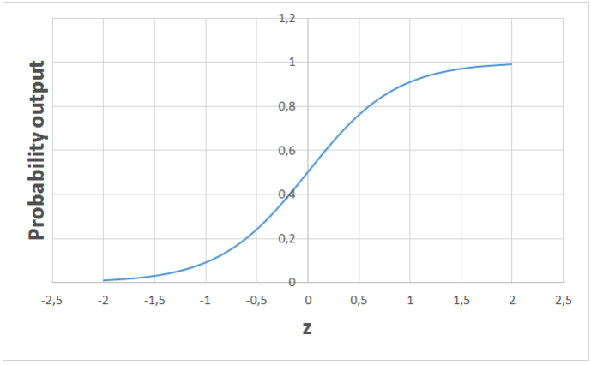
Logistic Regression
Supervised learning algorithm
Binary classification problems (0 or 1 – e.g., pass or fail, healthy or sick)
High bias / low variance
Takes in any real valued number and maps it to a value between 0 and 1

Slide 7
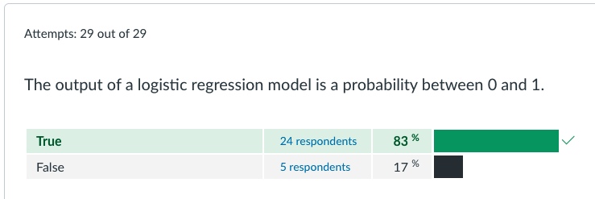
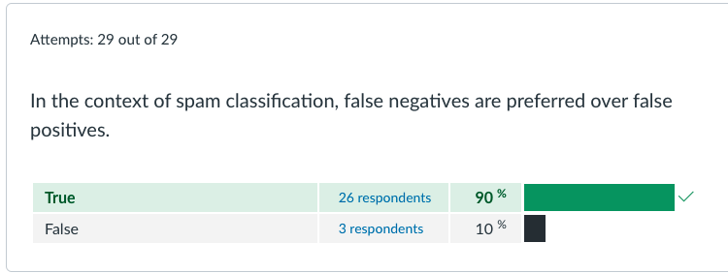
Quiz 4 (1)
False negative = email was incorrectly flagged as NOT spam (you see it in inbox)
False positive = email was incorrectly flagged as spam (you do not see it in inbox)

Slide 8
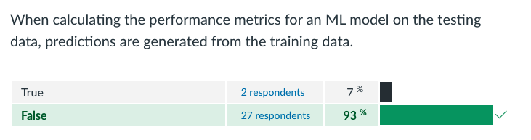
Quiz 4 (2)

Slide 9
Quiz responses:
Q12 | F | y_pred depends on both training data and test data. For example, in linear regression, Y_pred is beta * x_test beta is generated using the training data, while x_test is an x value in the test set. So this question could be both true or false... I wasn’t sure what to put there and I hope there will be some flexibility in grading this one...
Q4 | F | 1. If we treat the "output" as the dependent variable, then it is either 0 or 1 (binary), not a probability betwee; the question doesn't specify if the output refers to the dependent variable or the regression coefficient ; many instances of logistic regressions in machine learning context, "output" is treated as the dependent variable 2. More importantly, In ordinal logistic regression, the parameter estimates can be above 1 or below 0, the target variable can have three or more values with ordering. For example, the output can be movie rating from 1 to 5. Example: https://stats.oarc.ucla.edu/r/dae/ordinal-logistic-regression/
Q4 | F | Same as above. More focused on our coding process: one predicted label is an output; the array of predited labels is also the output.

Slide 10
Review
Cross-validation
Holdout cross-validation
k-fold cross-validation
Stratified k-fold cross-validation
Hyperparameters
Ridge (L1), Lasso (L2), and Elastic Net

Slide 11
Homework
LendingTree case study
Borrowers submit loan requests
Lenders
10,000 applications
LendingTree platform
2000 applications fulfilled (20%)
LendingTree earns a fee on successful loan requests
Success loan requests

Slide 12
Case study steps
Notes:
Ask clarifying questions
Identify the key goal of case study
Map out solution for how LendingTree can reach their goal (NOT ANALYSIS)
What analytic strategy (ML based) will reach address goal of study

Slide 13
Clarifying questions
Notes:
How does LendingTree earn revenue?
What is their business model?
What is LendingTree’s objective?
How will LendingTree increase success rate for closing a deal?
That’s why I hired you. How will i?
What data available?
What is criteria we use to give loans?
What is the objective of your company?
What is lendingtrees business? How do you make money?
How will you measure success?
I want to increase my profit margins by 5 times or 3 times
100,000 people → 20,000 applications
$10 per app = 200k per month
200k to 600k
Two ways:
20k apps to 60k apps
Increase that fee
Combination of both

Slide 14
Identify objective
Notes:
Filter out the people who will get rejected
Targeted approach – get mor people who will be given money
We have:
Financial characteristics of all borrowers
Rejected/accepted (0/1)

Slide 15
Map out solution
Notes:
Flag applications not likely to be fulfilled
Increase volume of good applicants
Predictive analytics can be used to
Two-fold:
Defining profile of those who will be accepted/rejected
Increasing market share – identifying those individuals who meet the qualities of accepted applicants
Profession / average income based on national data

Slide 16
Analytic strategy
Notes:
Label:
Approve / reject
Features:
Loan amount
Credit score
Debt to income ratio
Employment
Classification question
Decision Tree
Logistic regression
How are measure algorithm performance?
Accuracy measure
Confusion matrix (2 x 2)
Machine being sensitive to overfitting / lack of generalizability
k-fold cross validation – 10 the typical but this on data size
K-fold stratified (make sure 20% of acceptances are equally distributed across all folds)

Slide 17
Objectives
Learning with ensembles
Bagging and boosting (stacking)
Random forests (bagging)
Xgboost (boosting)

Slide 18
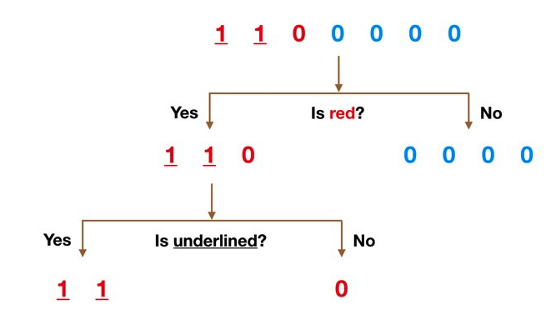
What/Why ensembles?
Individual Algorithms:
Sensitive to the training data
Poor generalizability
Prone to overfitting
“weak” learners
Ensemble learning combines two or more models to build a more accurate model
“strong” learners
More generalizable; less sensitive to training data; less prone to overfitting

Slide 19
Overview
Ensemble Learners (combining two or more algorithms)
Boosting and bagging are two approaches used in ensemble learning
Random Forest (bagging)
Xgboost (boosting)
Stacking is a third approach (not covered)

Slide 20
Bagging vs. Boosting
Bagging
Data partition is random
Goal is to reduce the variance in model
Each model is indepedent
Boosting
Misclassified data is given higher importance
goal is to increase prediction accuracy of model
Training of model for current step depends on prior step

Slide 21
Videos:
https://www.youtube.com/watch?v=Un9zObFjBH0
https://www.youtube.com/watch?v=2Mg8QD0F1dQ
https://www.youtube.com/watch?v=GM3CDQfQ4sw
https://www.youtube.com/watch?v=6yICuCnlh5Q
https://www.youtube.com/watch?v=v6VJ2RO66Ag&list=PLFHOcnnLIloy_iWAD8yTsDMBJUPdzH7hv&index=2&t=388s
https://www.youtube.com/watch?v=eLt4a8-316E

